Slide 1
Knuckles, The Robotic Arm
Andrew Blanchard, Matthew van Zuilekom, Rym Benchaabane, Paola Hernandez
Sponsored by MakerSpace
ECE 4335: ECE Systems Design
Faculty Advisor: Dr. Becker
Notes:
Andrew

Slide 2
Overall Project
What is Knuckles?
Assistive robotic arm that will hand the user requested objects and tools
Purpose
Increase the user’s productivity
Decrease the risk of dexterity incidents
Examples of users
Lab researchers
Elderly
People with disabilities
Notes:
roblem: people tend to multitask
Consequence:
Dexterity incidents
Time consumption
Increase of production or research costs
Need
Avoid dexterity accidents
A helping hand
More flexibility
Reduce time searching for items

Slide 3
User Analysis
User training requirement
Not much training; only voice commands
User support requirements
Power plug
Computer
Program to activate key words for voice commands (GUI)
Notes:
Knuckles is currently being developed for lab researchers, mechanics and people with disabilities.
Knuckles can be used for residential purposes.
Users will not require much training, as Knuckles will be controlled through voice commands.
Knuckles will be in need of a power plug, computer, program to activate key words for voice commands.

Slide 4
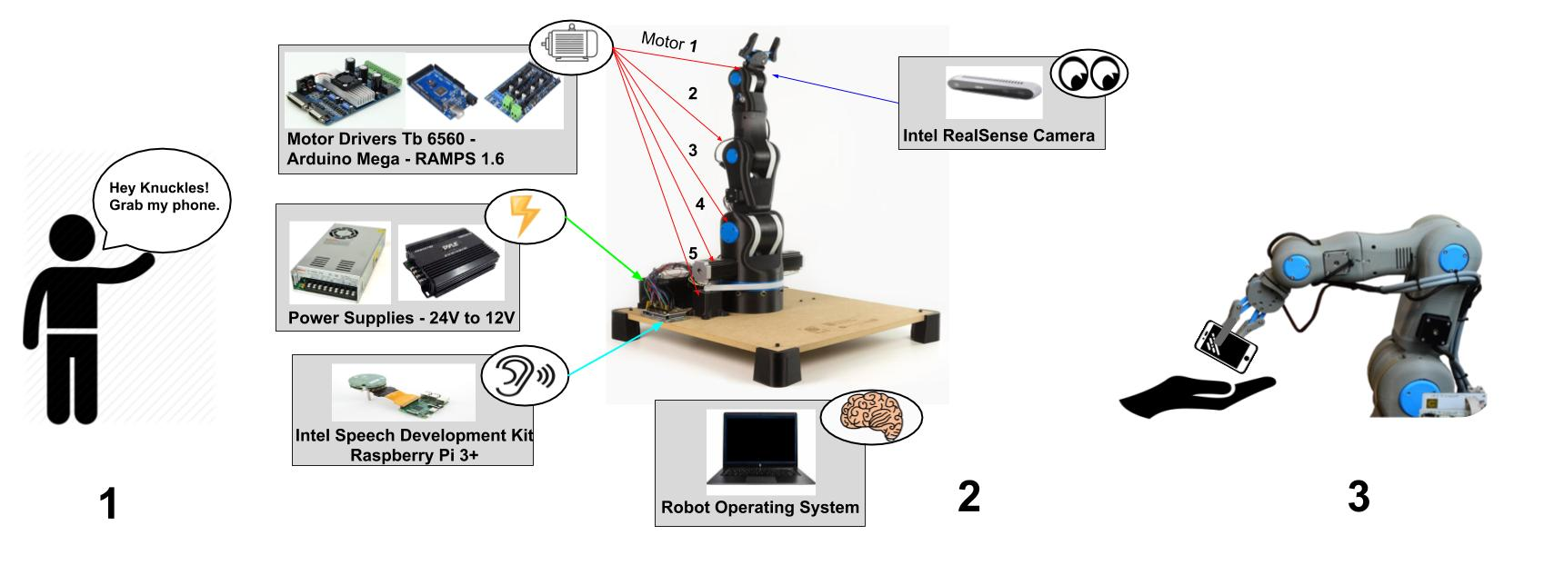
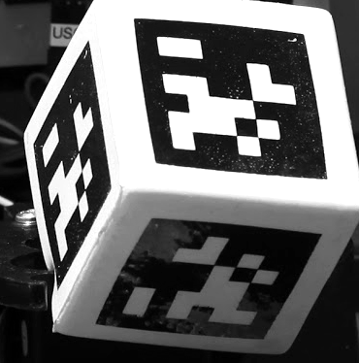

Overview Diagram
AprilTag
Figure 1. Overview of Knuckles functionalities
Notes:
Briefly go over this and mention that will go over more details in the design consideration about the firmware

Slide 5
Deliverables
Table 1. Deliverables per semester
FALL 2018 | WINTER BREAK | SPRING 2019
Assembling: Physical arm and gripper prototype building (95%) | Assembling: Tune gripper and arm motors motion (80%) | User Interface: Develop a Graphic User Interface (qtdesigner) (0%)
Hardware Purchased: (Intel RealSense camera, Intel mic, tactile pads) (90%) | Hardware Implementation Mount and install on Arm (Intel RealSense camera, Intel mic, tactile pads) (0%) | Automation Control: Arm moves using data from ROS (0%)
Object Detection: Recognize the AprilTag and associate it to an object (100%) | Object Detection: Arm follows the AprilTag (0%) | Voice Recognition: Convert voice to speech speech to object detection (0%)
Simulation: Arm functions on RViz (100%) | Communication System: Receive Feedback Signals from all hardware on ROS (0%) | Complete a fully functional robot!!
Notes:
Rym

Slide 6
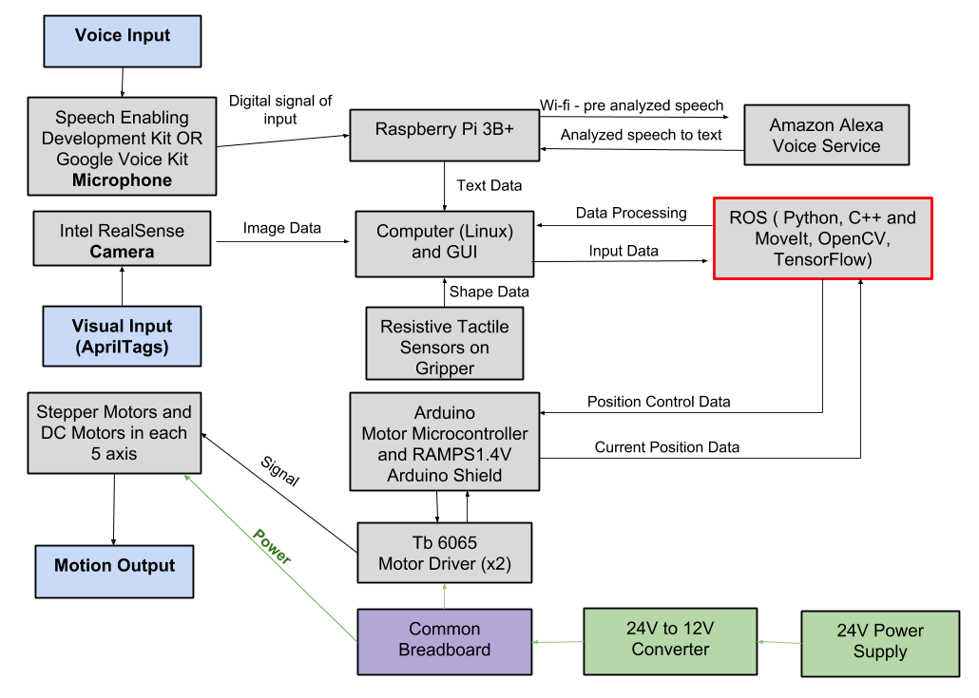
Design Considerations
Figure 2. Modular Diagram of Knuckles system

Slide 7
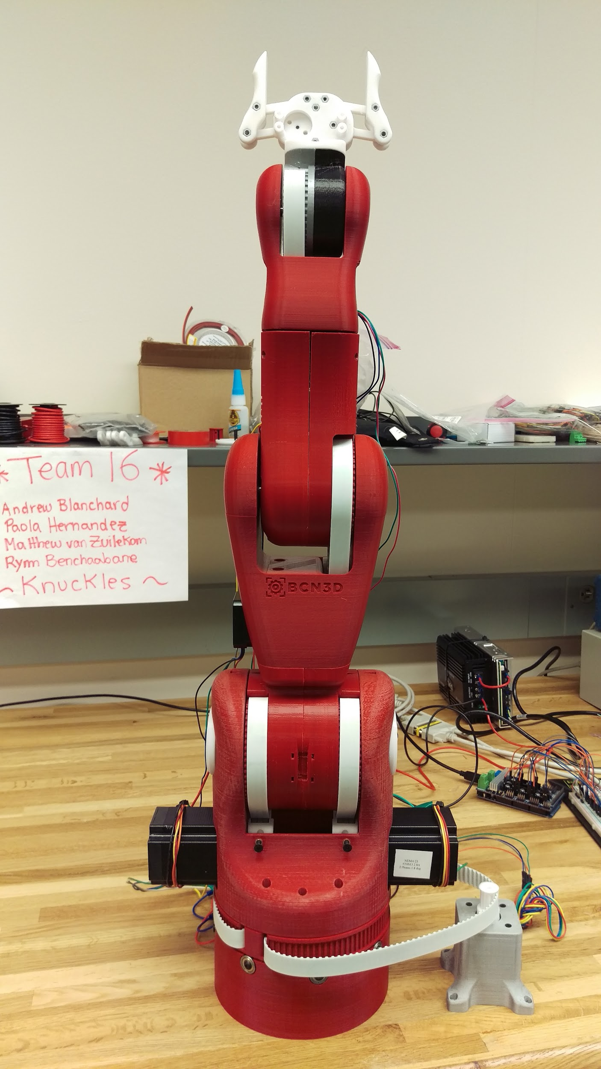
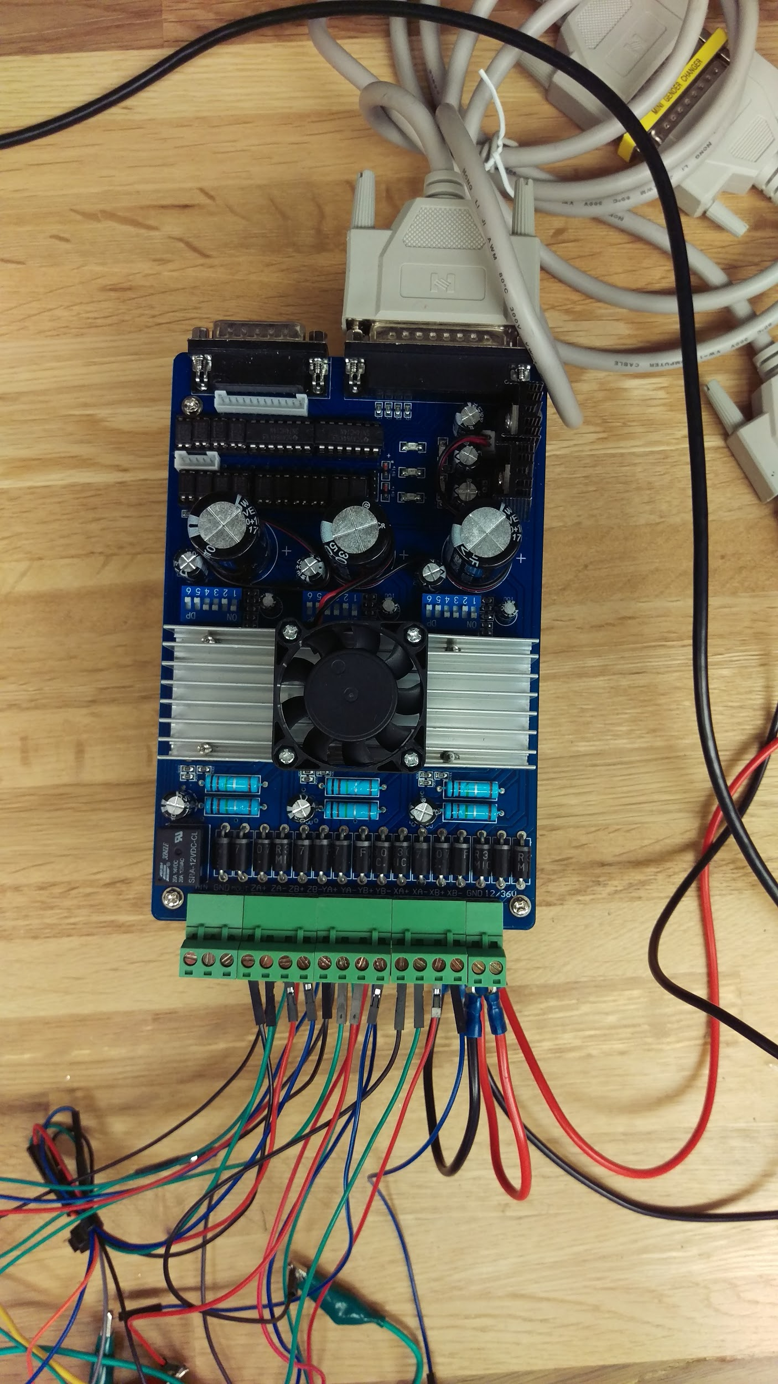
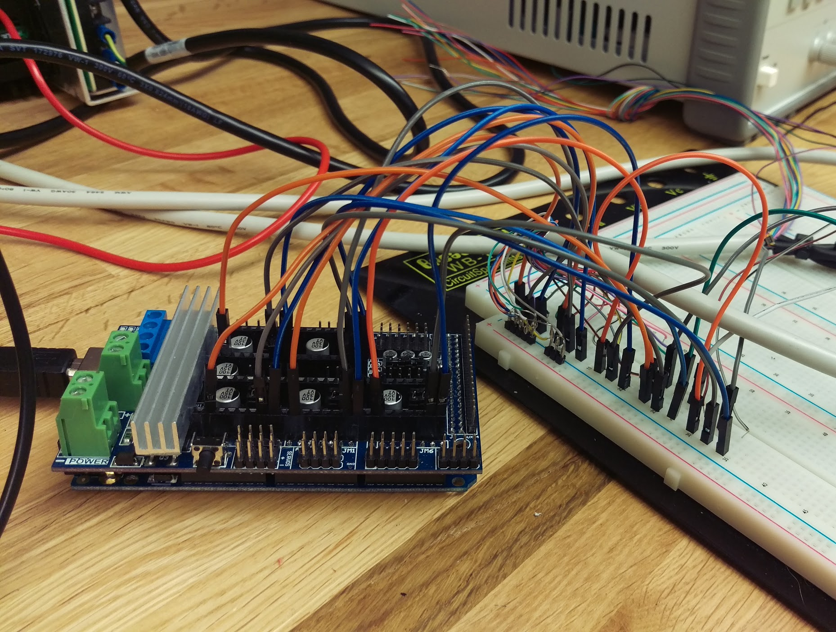
Figure 3. Arduino Mega 2560 + RAMPS V1.6 Pins connect to serial port inputs
Figure 4. Tb6560 Stepper Drivers
Figure 5. Knuckles, the robotic arm

Slide 8
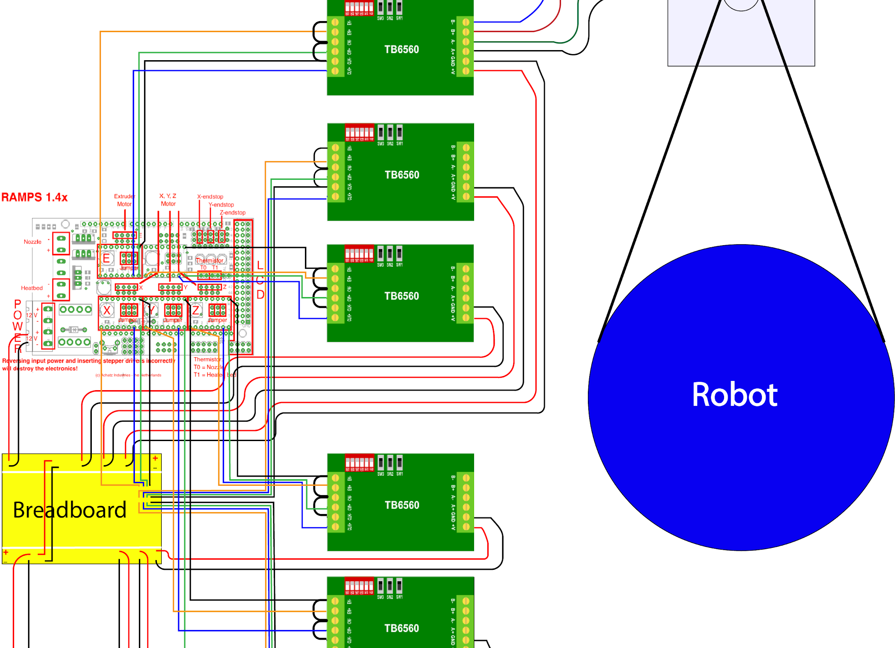
Figure 6. Stepper motors connections
Notes:
Matt

Slide 9
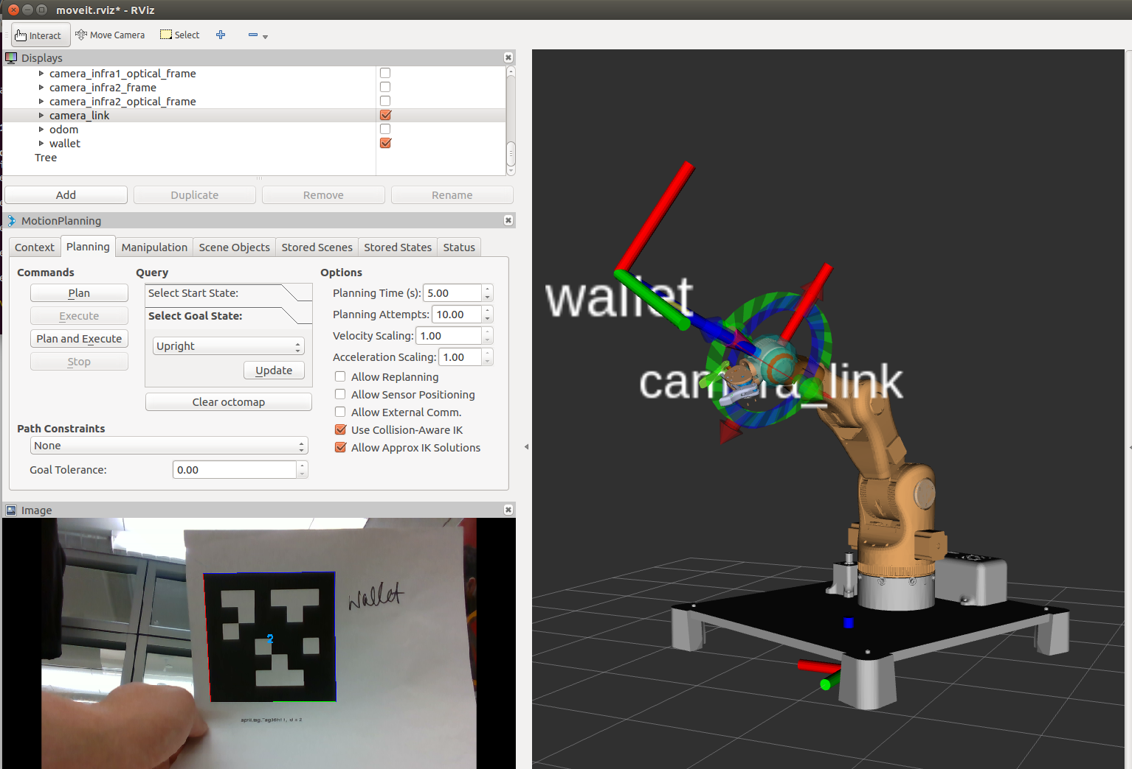
Figure 7. Knuckles model & AprilTag visualization on Rviz, ROS

Slide 10

Video 1. Demonstration of Knuckles moving

Slide 11
Design Constraints
Limited time
Less time to optimize the gripper design to accommodate more shapes
Limited weight to lift
Overheated motors
Limited vision field
RealSense depth camera can’t see within one foot

Slide 12
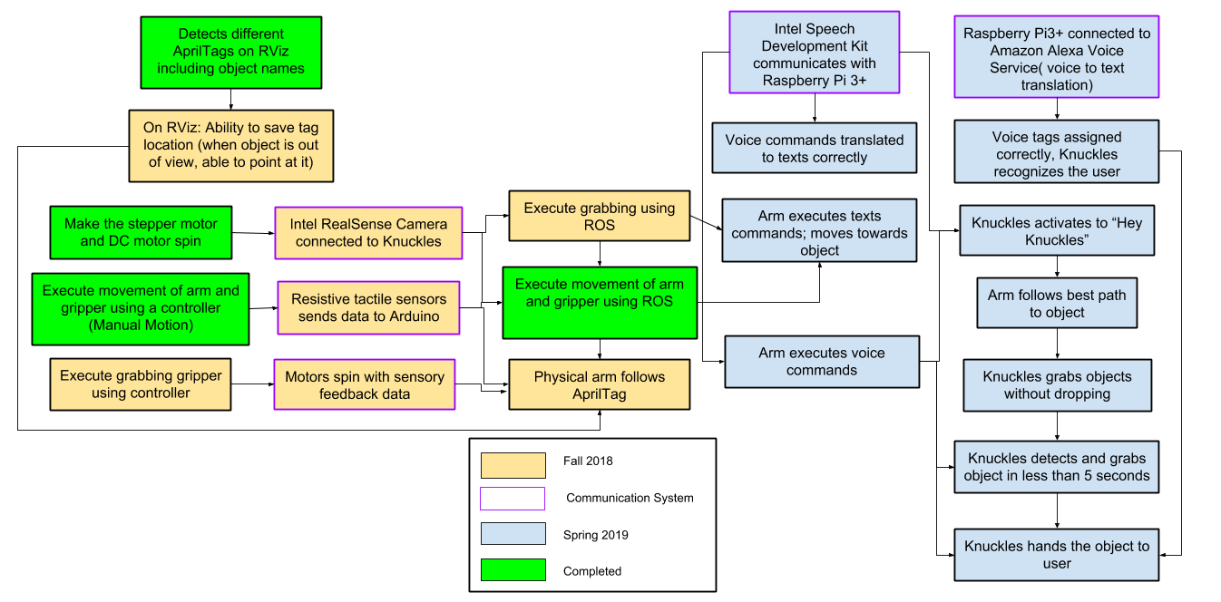
Target Objective - Goal Analysis
Figure 8. Goals and work progress
Notes:
Paola

Slide 13
Test Plan
December:
Test the mobility of the robot: Verify the arm and gripper motion with a controller and when connected to ROS.
Test the search function: Use text commands to have the robot point at objects.
Test the retrieval function: Use text commands to retrieve an object
Notes:
List test plan

Slide 14
Test Plan
January:
Test the voice recognition: Compare voice commands to the text in the ROS terminal.
Test the gripper with the return: Robot presents user with object and waits until the user pulls on the object to let go.
February:
Last minute tuning
Mid-March:
2019 ECEDHA Conference in Tucson, Arizona
Notes:
Replace image with reflection image

Slide 15
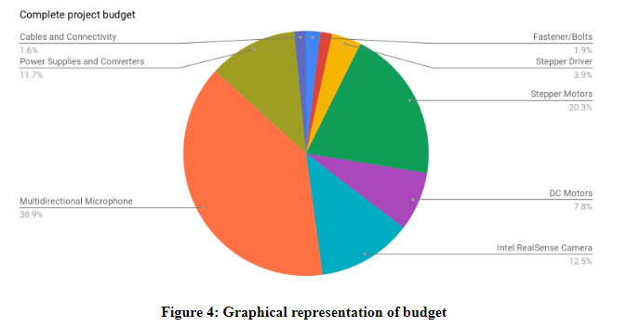
Budget
Total Budget: $1,800
Used 59.2%
.
Figure 9. Budget pie chart
Notes:
Round corners

Slide 16
Project Conclusion
Assistive robotic arm, increase productivity
Great opportunity to learn about robotics, Linux & ROS
Test plan
Modular plan will help us accomplish our goals
Current progress
Used 59.2% of budget
Almost fully built robot

Slide 17
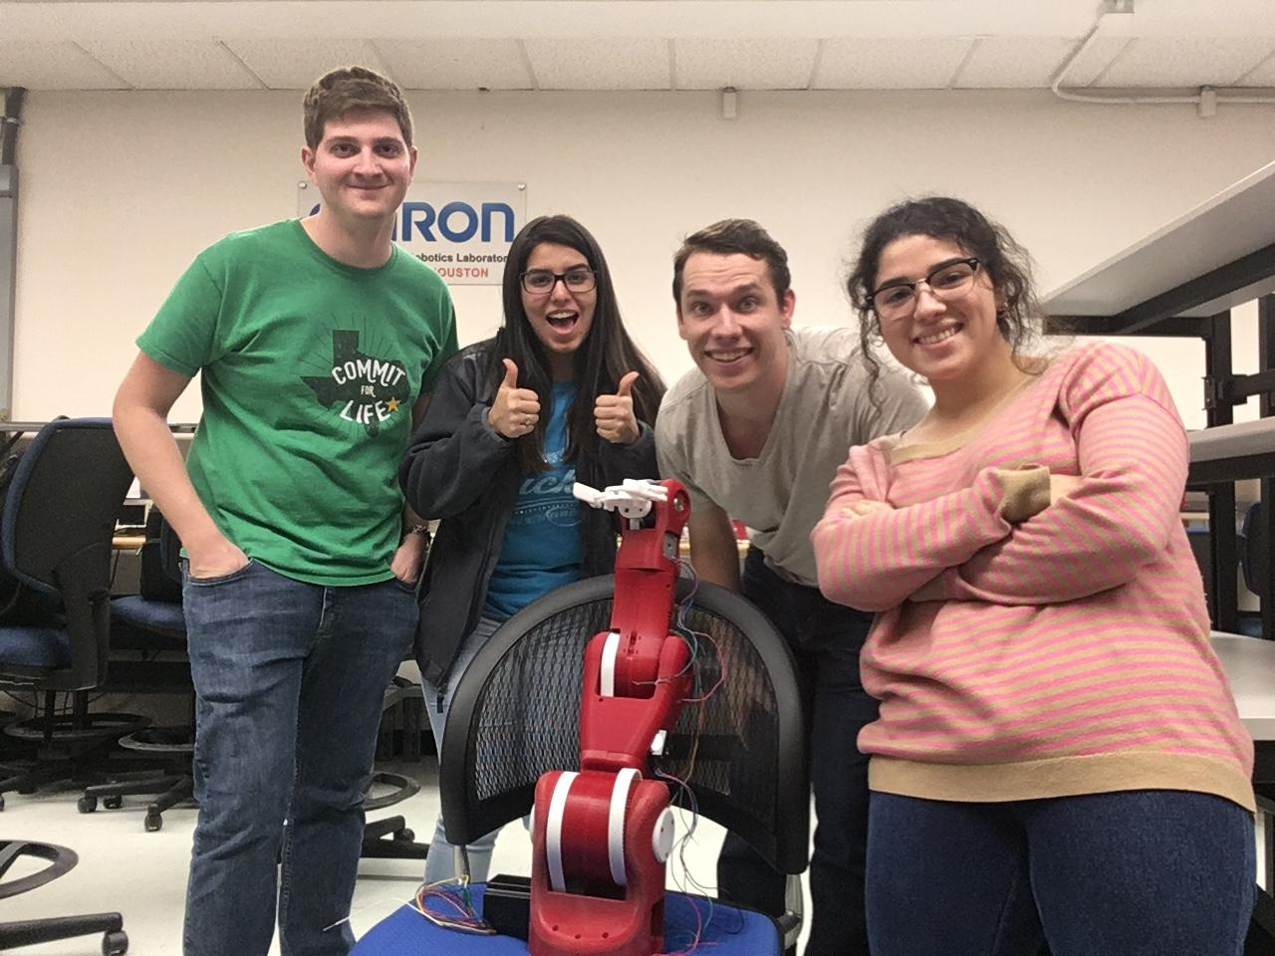
Thank you for your attention
QUESTIONS?
Notes:
Yay

